Slide 1


Smart Automation
for Smarter Insurance
Decisions
From Manual Processing
to Automated Financial Insights
Page 1

Slide 2
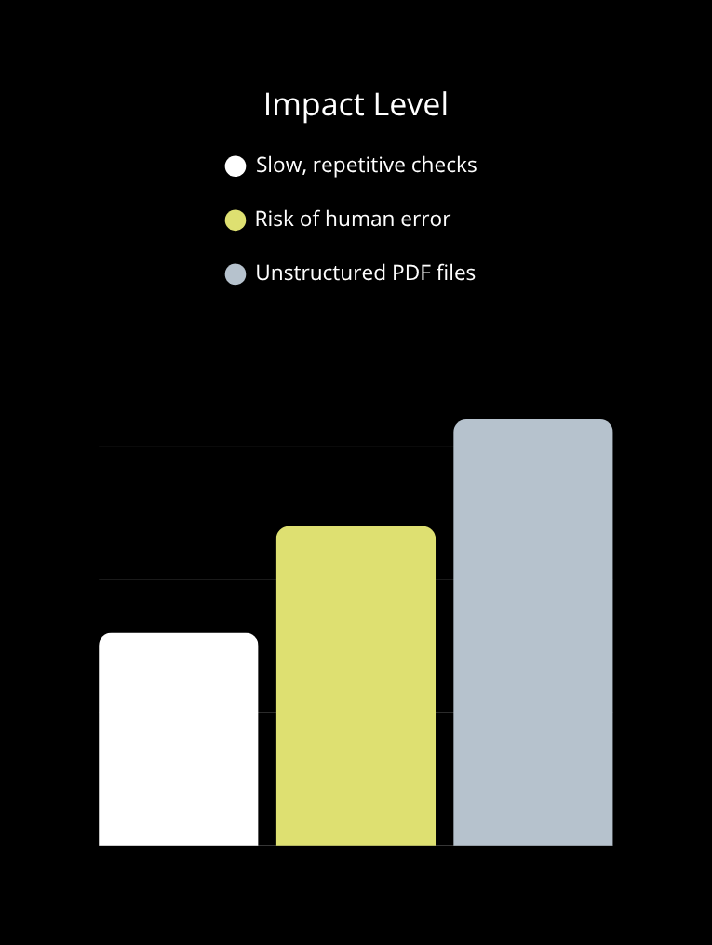
Core Challenge Unveiled
Where Manual Processing Meets Its Limits
Too slow to scale :
Manual data checks can’t keep up with the growing volume of reports.
Mistakes are inevitable :
Human intervention leads to inconsistency and undetected errors.
PDF chaos = Insight lost :
Unstructured and variable layouts make extraction inefficient.
Page 2

Slide 3









Unlocking the Solution
Core Idea – Automate. Normalize. Validate.
Smart Cleaning
Data Normalization
PDF Financial Reports
(CMF – scraped automatically)
Automated Detection
Validated, Clean Excel Tables
(Ready for analytics)
Validation Loop
-Turning Raw Data into Actionable Insights-
Page 3
No manual work – No repetitive checks – 100% automation

Slide 4




Unlocking the Solution
Milestones to Hit – Broader Impact on the Insurance Sector
Boosted Strategic Agility :
Real-time data unlocks faster and smarter business moves.
Trustworthy Insights :
Leaner Operations :
Validated data builds confidence across stakeholders and regulators.
Automating repetitive tasks frees up expert time for high-value work.
Industry-Wide Data Standards :
Normalized reporting sets the ground for cross-company comparison.
Page 4

Slide 5

Project Workflow
How the Project Works – From Input to Output
Phase 1 :
Automated Data Processing & Extraction
Phase 2 :
Data Validation & Transformation
A Two-Phase Journey :
Extraction First, Validation Next
Page 5

Slide 6

Project Workflow
Phase 1 :
Automated Data Processing & Extraction
Accurate extraction of critical financial tables
Laying the groundwork for seamless data validation
Dramatic reduction in manual workload :
from hours to minutes
Enabling data-driven decisions with tructured data
-Unlocking Hidden Data : Automating Financial Extraction-
Page 6

Slide 7


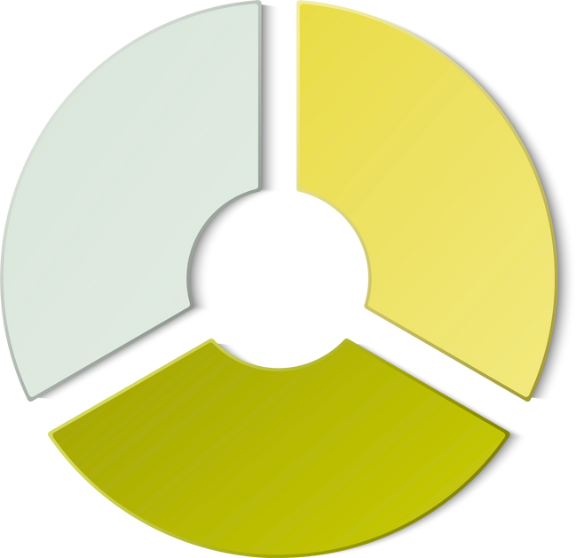
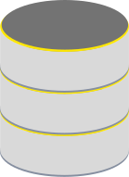
Project Workflow
Phase 1 :
Automated Data Processing & Extraction
Web Scraping :
PDF Extraction :
Selenium :
Camelot :
Automates download of financial PDFs from CMF website
Extracts structured tables (like Annexe 13) from native PDFs
Python Requests
OpenPyXL / XlsxWriter :
For Excel output formatting
Database :
MySQL :
Stores downloaded and processed documents
SQLAlchemy :
Manages interactions between Python and MySQL
-Behind the Automation : Languages & tools orchestrating automatic data flow-
Page 7

Slide 8




Project Workflow
Phase 1 :
Automated Data Processing & Extraction
1. Targeted PDF Retrieval
2. Database Initialization & Management
3. Metadata Logging
Scraping of financial reports from the CMF website using Selenium.
Systematic recording of metadata (company name, year, ...).
Automated creation and structuring of the database.
-The Automation Journey : Step-by-step execution of the data extraction phase-
Page 8

Slide 9

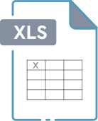
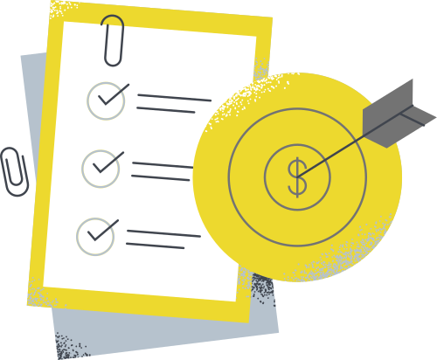
Project Workflow
Phase 1 :
Automated Data Processing & Extraction
4. Annex 13 Detection
5. Table Extraction
6. Excel Export
Output ready for Phase 2
Scanning the PDF to locate the financial table "Annex 13".
Extracting the detected table from the PDF.
Converting the extracted table into a structured Excel file.
-The Automation Journey : Step-by-step execution of the data extraction phase-
Page 9

Slide 10
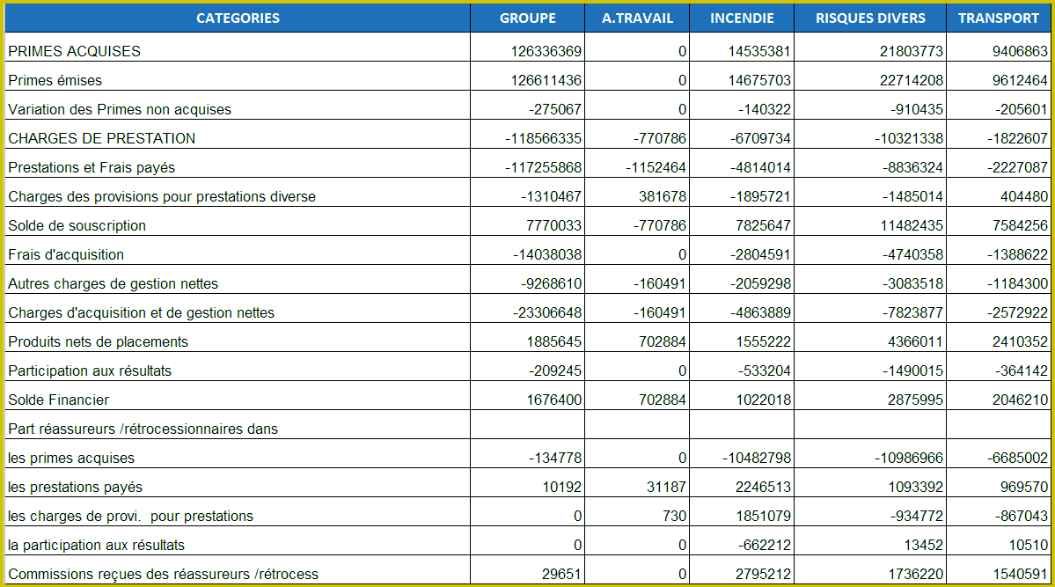
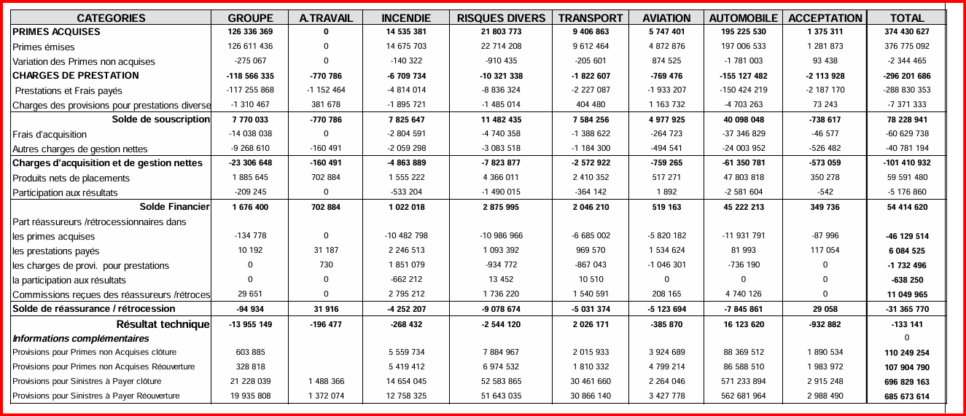
Project Workflow
Phase 1 :
Automated Data Processing & Extraction
-Input : Annex 13 table in the original PDF-
-Output : Extracted Excel version of the same table-
- Case Study: STAR Insurance (Annex 13 Extraction) : A visual before-and-after of automated data extraction-
Page 10

Slide 11
Project Workflow
Phase 2 :
Data Validation & Transformation
Bring harmony across datasets to enable seamless comparisons between years and companies.
Deliver structured and validated financial tables that are ready for storage, analysis, and reporting.
Ensure that only clean, corrected, and rule-compliant data feeds the decision-making chain.
Minimize manual intervention by automating detection of common data issues.
-From Raw to Reliable : Automated Data Cleansing-
Page 11

Slide 12


Project Workflow
Phase 2 :
Data Validation & Transformation
Programming & Data Manipulation :
Data Normalization & Validation :
Python :
fuzzywuzzy :
Automates download of financial PDFs from CMF website
Fuzzy string matching to standardize column and row names against a predefined reference list, correcting typos
and variations automatically.
pandas :
Handling, cleaning, and manipulating tabular data.
re :
Regular expressions for pattern matching and data cleaning.
OpenPyXL :
Excel file handling and coloring cells
Database & Automation :
MySQL :
Database for storing and tracking file validation status (pending, invalid, valid).
CTRL+S Listener:
Detects manual corrections on Excel files, triggers automatic re-validation until files are fully validated.
-Behind the Automation : Languages & tools orchestrating automatic data flow-
Page 12

Slide 13






Project Workflow
Phase 2 :
Data Validation & Transformation
1.Column & Row Name Normalization
2.Symbol & Character Detection
3.Business Rule Validation
4.Auto-Recheck Loop
Standardize headers using fuzzy matching
Fix inconsistencies by aligning names with a predefined reference list
Scan each cell for unwanted letters/symbols
If found → clean the value
Highlight cleaned cells in green
Apply predefined accounting rules to rows/columns
If mismatch → highlight intersecting cells in red
If no red cells → mark file as “valid” and save to DB
If red cells detected:
→ Wait for manual correction
→ Once CTRL+S is detected → re-launch validation
→ Loop until file is clean
-The Validation Journey : Step-by-step execution of the data extraction phase-
Page 13

Slide 14

Project Workflow
Phase 2 :
Data Validation & Transformation
Clean structure with normalized row & column names
No symbols or invalid characters
Final Output
All values verified & color-coded ( cleaned, flagged)
Automatically saved to the validated files database
100% ready for reliable financial analysis
-Let the Code Work : From Scraping to Validation, Automatically-
Page 14

Slide 15
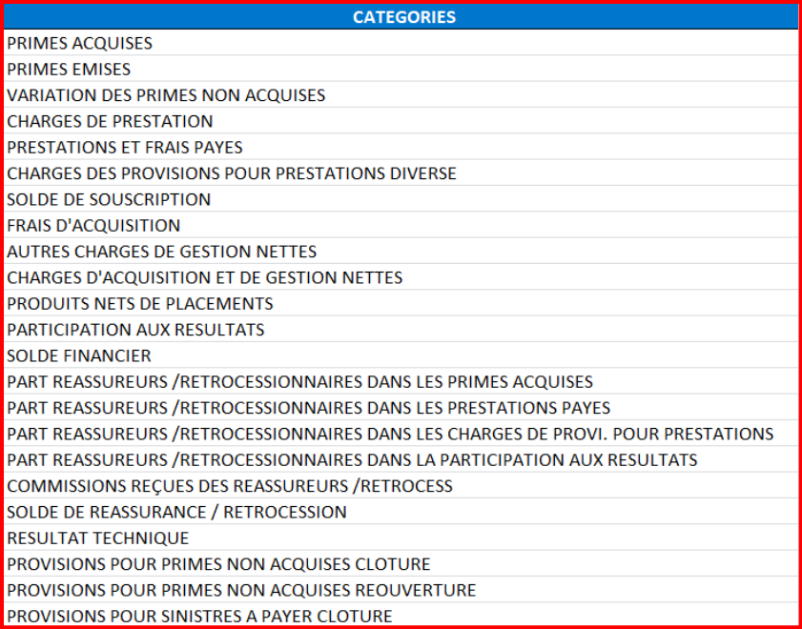
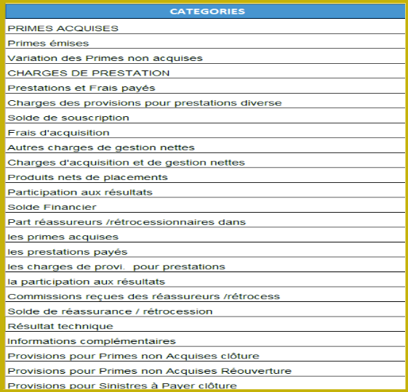
Project Workflow
Phase 2 :
Data Validation & Transformation
-Input : Before Row Label Standardization-
-Output : After Row Label Standardization-
- Case Study: STAR Insurance (Annex 13 Extraction) : Transforming Inconsistencies into Structured, Validated Data-
Page 15

Slide 16



Project Workflow
Phase 2 :
Data Validation & Transformation
-Input : Before Column Header Normalization-
-Output : After Column Header Normalization-
- Case Study: STAR Insurance (Annex 13 Extraction) : Transforming Inconsistencies into Structured, Validated Data-
Page 16

Slide 17
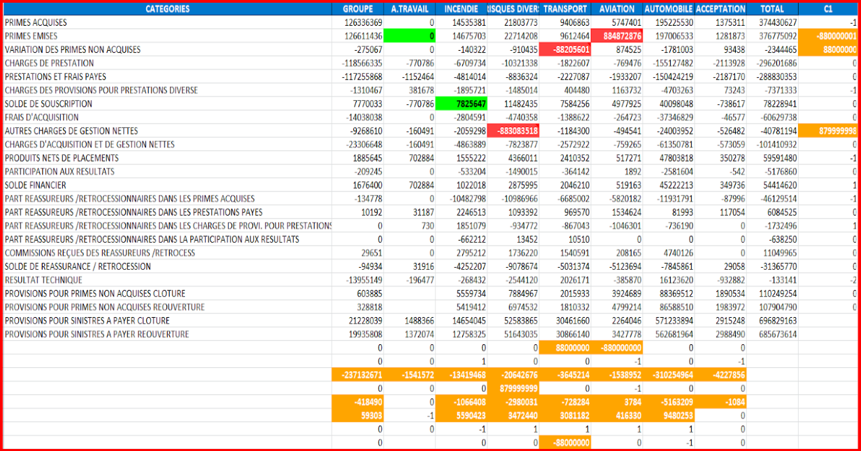
Project Workflow
Phase 2 :
Data Validation & Transformation
Visual Outcome of Automated Data Checks
-Output : Final Data Validation Outcome-
- Case Study: STAR Insurance (Annex 13 Extraction) : Transforming Inconsistencies into Structured, Validated Data-
Page 17

Slide 18
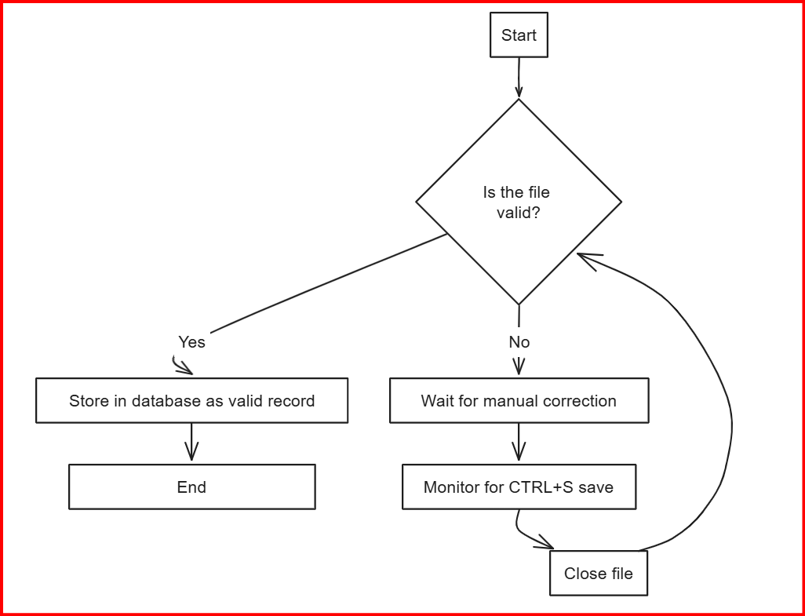

Project Workflow
Phase 2 :
Data Validation & Transformation
A smart loop that never quits until the job is 100% done.
Validate, correct, repeat :
until zero errors remain.
- Smart Validation Loop : Ensuring data accuracy through automated iteration-
Page 18

Slide 19



Next Frontier : From Clean Data to Smart Decisions
Unlocking the full value of automation through dashboards and forecasting
A natural continuation of this project would be to build a dynamic visualization and forecasting layer, powered by tools like Power BI.
Page 19

Slide 20
Next Frontier : From Clean Data to Smart Decisions
Unlocking the full value of automation through dashboards and forecasting
This phase would enable :
Automated Financial Dashboards :
Forecasting with Machine Learning :
Real-time dashboards built directly from validated data.
Use past patterns to generate projections and guide decisions.
Live Visualization of Key Metrics :
Enhanced Decision-Making :
Turn clean data into actionable insights for insurance stakeholders.
Monitor gaps, balances, ratios, and historical trends dynamically.
Page 20

